Slide 1
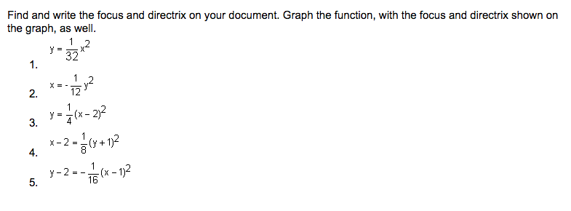
Parabolas: 9.02
Isabella King

Slide 2
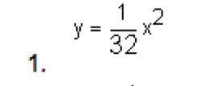
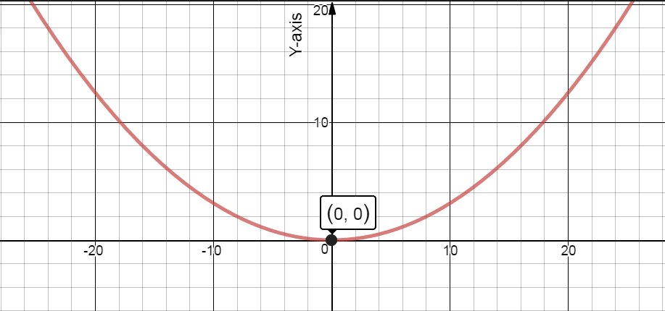
Focus:
Directrix:

Slide 3
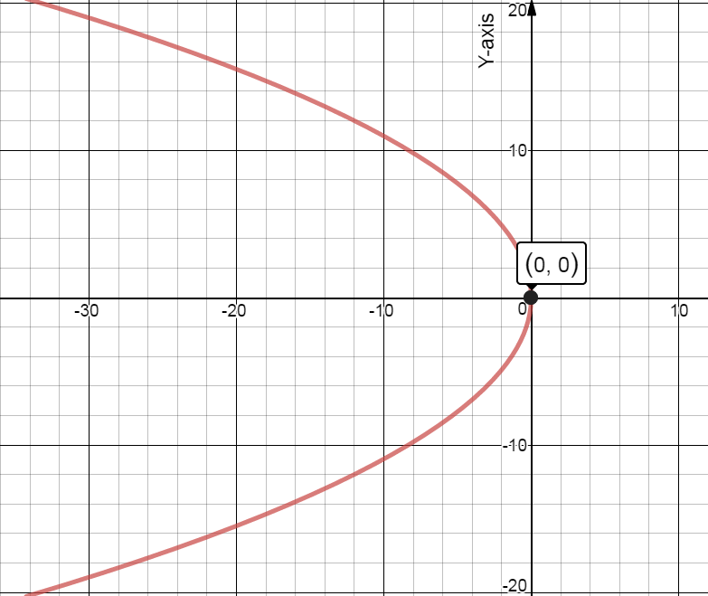

Focus:
Directrix:

Slide 4

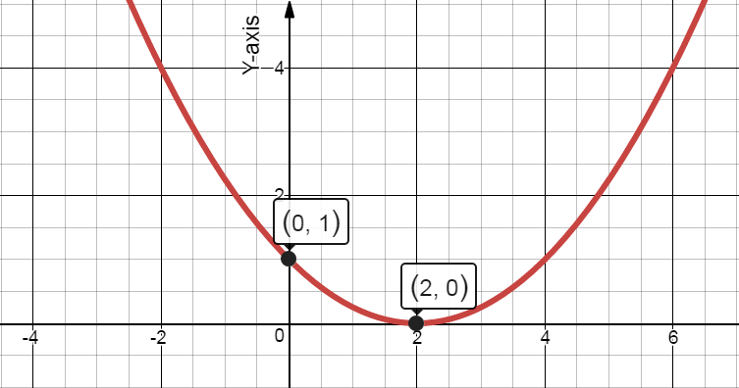
Focus:
Directrix:

Slide 5
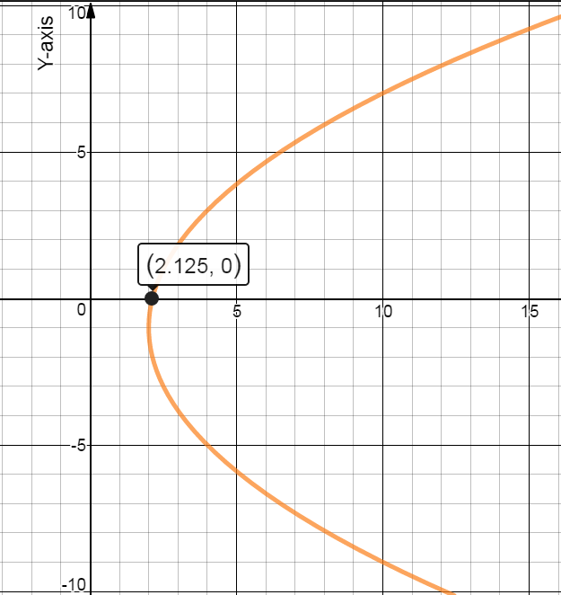

Focus:
Directrix:

Slide 6

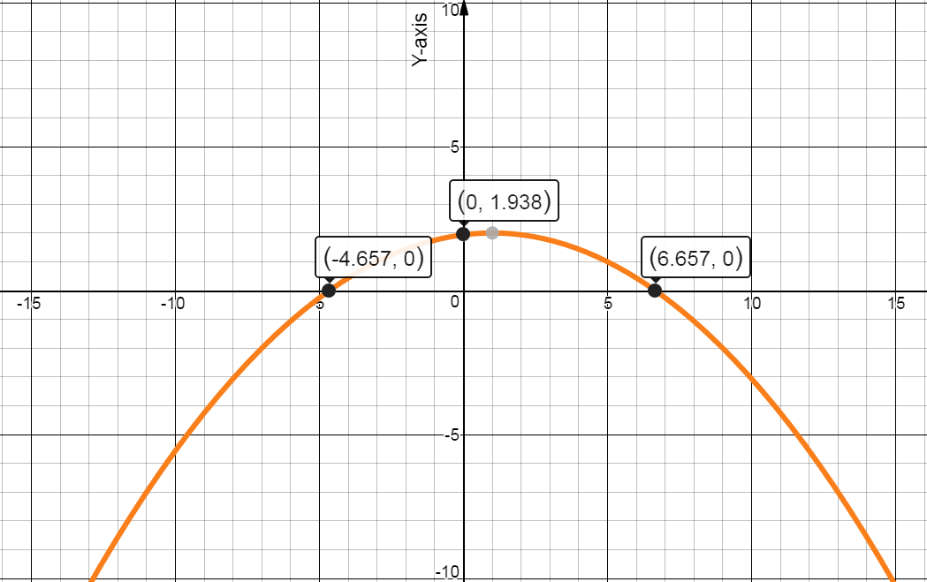
Focus:
Directrix:

